Slide 1
Electronic Circuits 1
Project
Aaron Bading
David Maples
Luke Lockett
For our project we built an audio amplifier.
The amplifier circuit utilizes a transistor, resistors and capacitors.

Slide 2
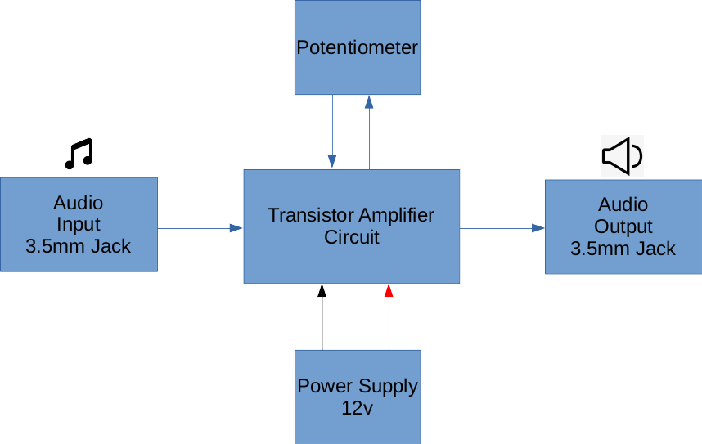
Block Diagram

Slide 3
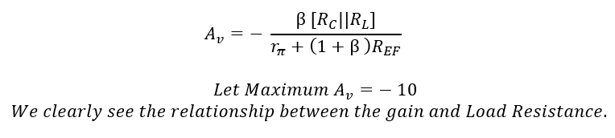
Why does the amplifier work ?

Slide 4
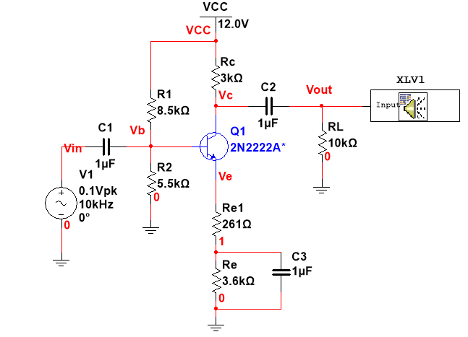
Multisim schematic

Slide 5
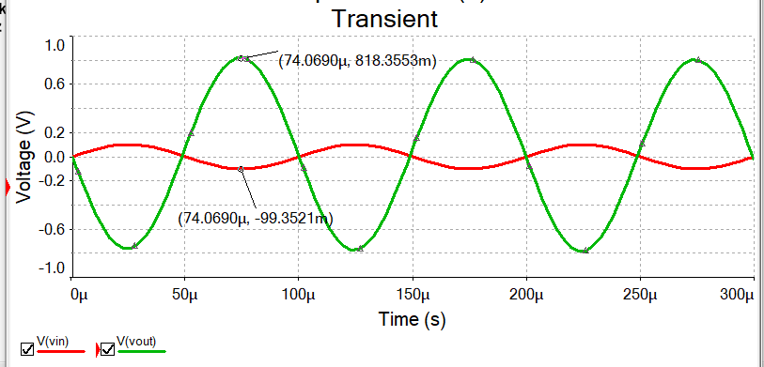
Amplification at Max Load Resistance

Slide 6
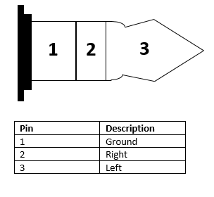
3.5mm TRS schematic (headphone jack)
Sleeve
Ring
Tip
Black
Red
White

Slide 7
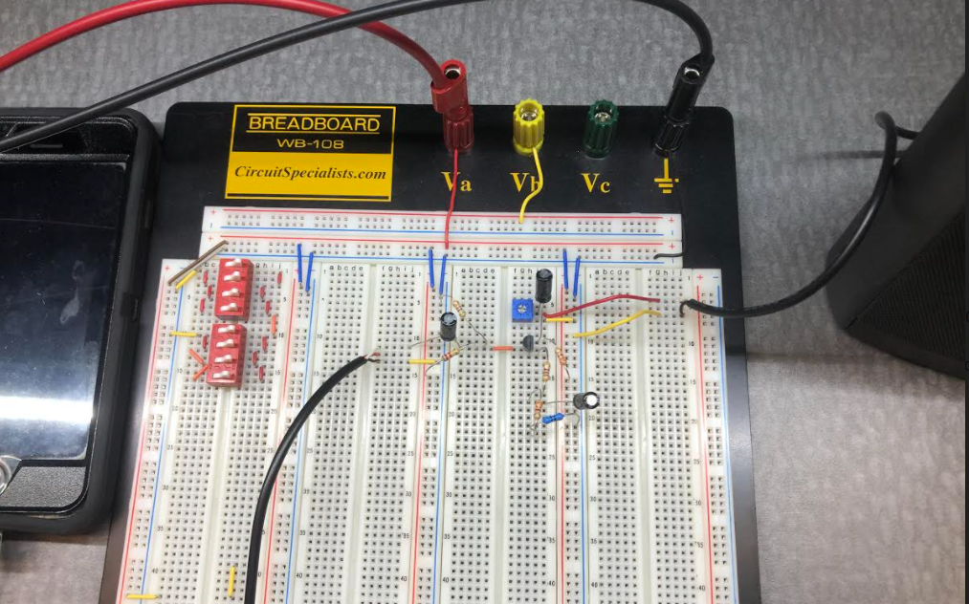
Finished Circuit
Potentiometer
Audio Input
Audio Output
Amplifier Circuit

Slide 8
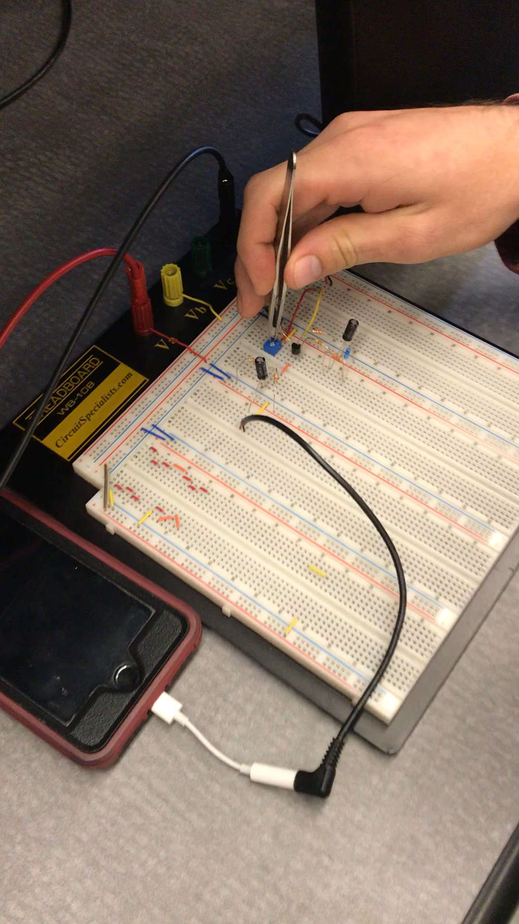
Finished Circuit

